Slide 1

Grade 10
Lesson 6: The Choice Moment

Slide 2


Discussion Questions
What does the word stimulus mean?
What are some examples of stimuli?
How does understanding stimuli help us better ourselves?
How do your 5 senses connect to feelings and emotions?
Why is it important to know how we process information through our senses?
Is there a moment in between stimulus and our response?
Notes:
Teacher Script:
“What does the word stimulus mean?” Write responses on the white board.
Answer: Stimulus is any factor or event in the environment that can provoke a response or reaction.
“What are some examples of stimuli?”
Answer: Sounds, temperature, taste, smell, social interactions, etc.
“How does understanding stimuli help us better ourselves?”
Answer:
1. Increases self awareness
2. Supports better self regulation
3. Encourages self improvement
4. Allows us to communicate more effectively
“What are our 5 senses?”
Answer: Hearing, Sight, Taste, Smell and Touch
“How do your 5 senses connect to feelings and emotions?”
Answer: All 5 senses can evoke memories that are tied to emotions therefore the smell of a baked cookie may make you feel happy while the smell of a skunk may make you feel disgusted or sick.
“Why is it important to know how we process information through our senses?”
Answers: enhances sensory awareness, improves cognitive functioning, helps manage sensory overload, improves communication, help us better understand ourselves and others, promotes well being
“Is there a moment in between stimulus and our response?”
Answer: Yes! This pause in the Choose Love Program is called the Choice Moment. It refers to the mental space created by responding consciously and deliberately rather than reacting automatically to external stimuli. It empowers us to use our self-awareness and self-regulation skills in managing our responses and fostering personal growth. When we use the Choice Moment we lead ourselves to making Heroic choices rather than reactive choices..

Slide 3
Practicing the Pause
Strategies
Take a deep breath
Acknowledge your emotions
Consider consequences
Empathize with others
Practice active listening
Give yourself time
Use positive self-talk
Visualize your ideal response
Practice mindfulness
Notes:
Teacher Script:
“We are going to practice different ways to maximize the time in between stimulus and response so we can react in thoughtful, healthy ways. Using the strategies below, I want you to reflect in your journals about an event I will share with you and write down, in order, the top three strategies you would use. Remember, there is no right or wrong answer, it’s what works best for you.
Strategies:
Take a Deep Breath
Acknowledge Your Emotions
Consider Consequences
Empathize with Others
Practice Active Listening
Give Yourself Time
Use Positive Self-Talk
Visualize Your Ideal Response
Practice Mindfulness
“Scenario 1: You have to give a big speech in front of the entire grade level.
Scenario 2: You’re taking a huge test and you come to a difficult question that you don’t know how to answer.
Scenario 3: You’re in a crowded room and someone pushes you out of their way.
Scenario 4: You get locked out of your car or house and have no spare key and somewhere important to be in 10 minutes.”
“Did you notice any pattern to your responses? Did you favor one strategy over another or avoid a strategy altogether?”

Slide 4
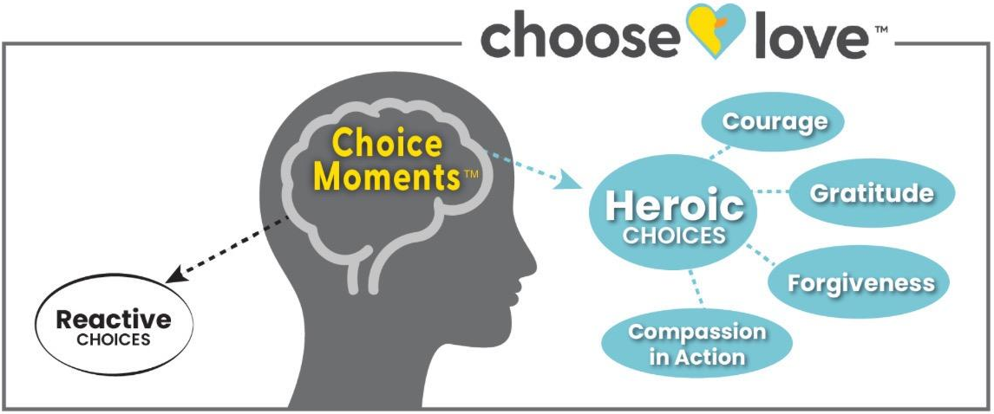
Choice Moment Model
Choice Moment Video
Notes:
Teacher Script:
“The Choice Moment is where our personal power resides! The Choice Moment is the pause in between what’s happening in our life, and our response. This pause happens in the present moment, where life is happening. It helps us to get curious about what’s happening around us and get more information. We have two choices in how we will respond. We can make a Heroic Choice, when we thoughtfully respond with courage, gratitude, forgiveness or compassion in action. The other choice is simply to react, without much thought. When we react, the fear center of our brain might take over. When this happens, we react without pausing to consider all the information at hand. Our reaction then is uninformed and could not be the best response possible. In most instances, it is a good idea to utilize the pause that occurs within the Choice Moment to consider our response. Otherwise we are reacting and the executive functioning part of our brain is not in control. By recognizing this crucial space for choice, we have the ability to respond thoughtfully, aligning our actions with our values, and being the best version of ourselves!”

Slide 5

Choose Love Journal Prompt
“The greatest revolution of our generation is the discovery that human beings, by changing the inner attitudes of their minds, can change the outer aspects of their lives.” - William James
How can you use your new knowledge of the Choice Moment to impact your life?

Slide 6

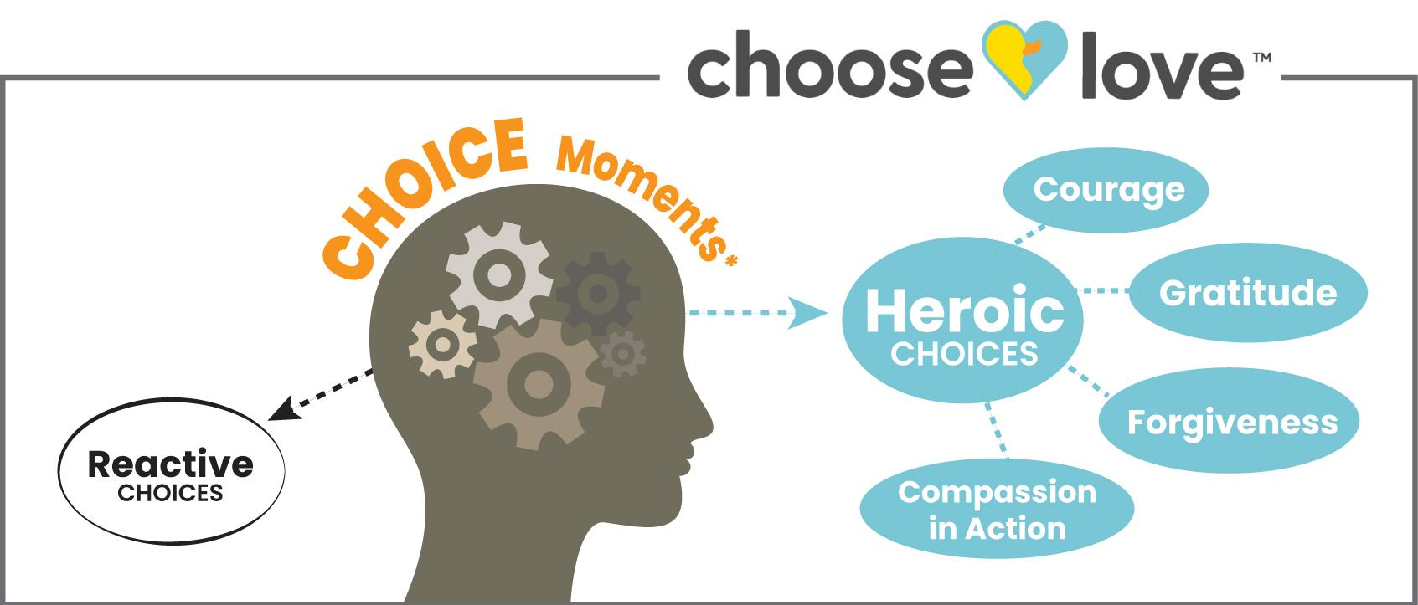






Lessons to Life
How does engaging in the Choice Moment contribute to personal growth, self-esteem and overall well-being?
Look at the Choice Moment Model below. Where do you see the Choice Moment on the Choice Moment Model? Why do you think it’s placed there?

