Slide 1

First Grade
Courage Lesson 5
Courage and The Brave Breath
Brave Breath and Rest and Relax activities help our bodies, minds, and hearts to learn and practice Courage.

Slide 2
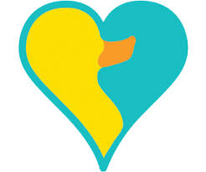

Daily Dose of Love
“Courage is grace under pressure.”
~Ernest Hemingway

Slide 3
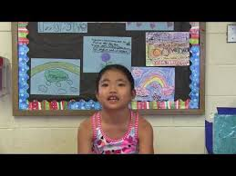
Focused Awareness
Courage and the Brave Breath by Students in Hawaii
Notes:
SafeShare Video Link: http://safesha.re/io8
“Today, we will learn how to take a Brave Breath. This will help us have courage and get ready to learn.”
“First, place your hands on your belly. Take a slow, deep breath, and count to 4 in your mind. Feel your belly get bigger and full of air, like a balloon. Now count to four and slowly breathe out.”

Slide 4
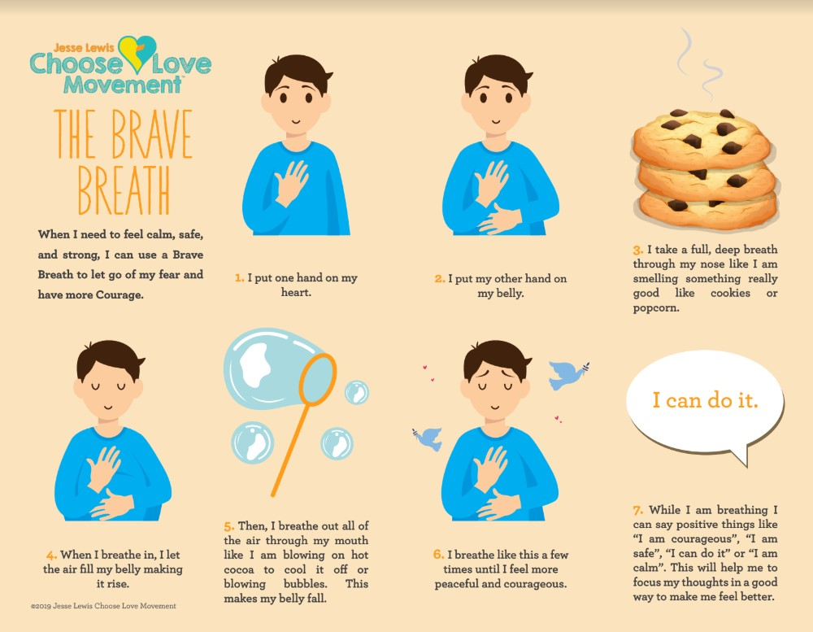
Focused Awareness
Notes:
“Today, we will learn how to take a Brave Breath. This will help us have courage and get ready to learn.”
“First, place your hands on your belly. Take a slow, deep breath, and count to 4 in your mind. Feel your belly get bigger and full of air, like a balloon. Now count to four and slowly breathe out.”
“Today, we will learn how to take a Brave Breath. This will help us have courage and get ready to learn.”
“First, place your hands on your belly. Take a slow, deep breath, and count to 4 in your mind. Feel your belly get bigger and full of air, like a balloon. Now count to four and slowly breathe out.”

Slide 5

The Journey
Notes:
Review Choose Love Formula

Slide 6

The Journey
American Sign Language for Courage
By Emily
Notes:
SafeShare Video Link: http://safesha.re/iqw

Slide 7
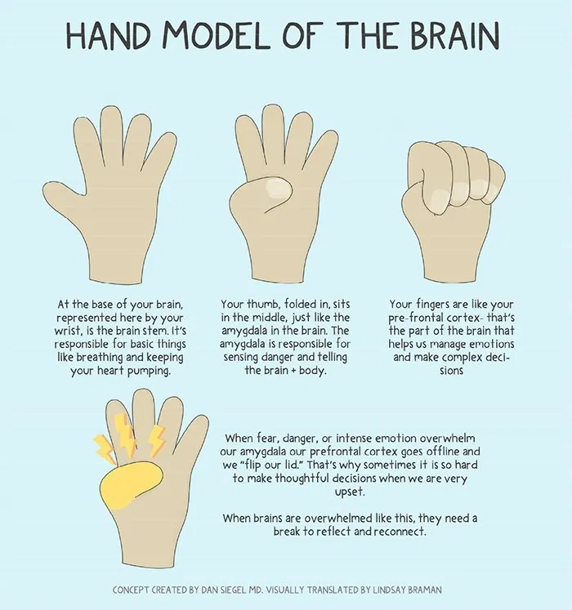
The Journey
Notes:
“In order to help us understand what’s happening in our brains, we’re going to use our hand as a model of our brain. Hold your hand up like you’re going to give someone a high-five. Tuck your thumb into the palm of your hand, and close your fingers over your thumb.”
(More in lesson plan)

Slide 8
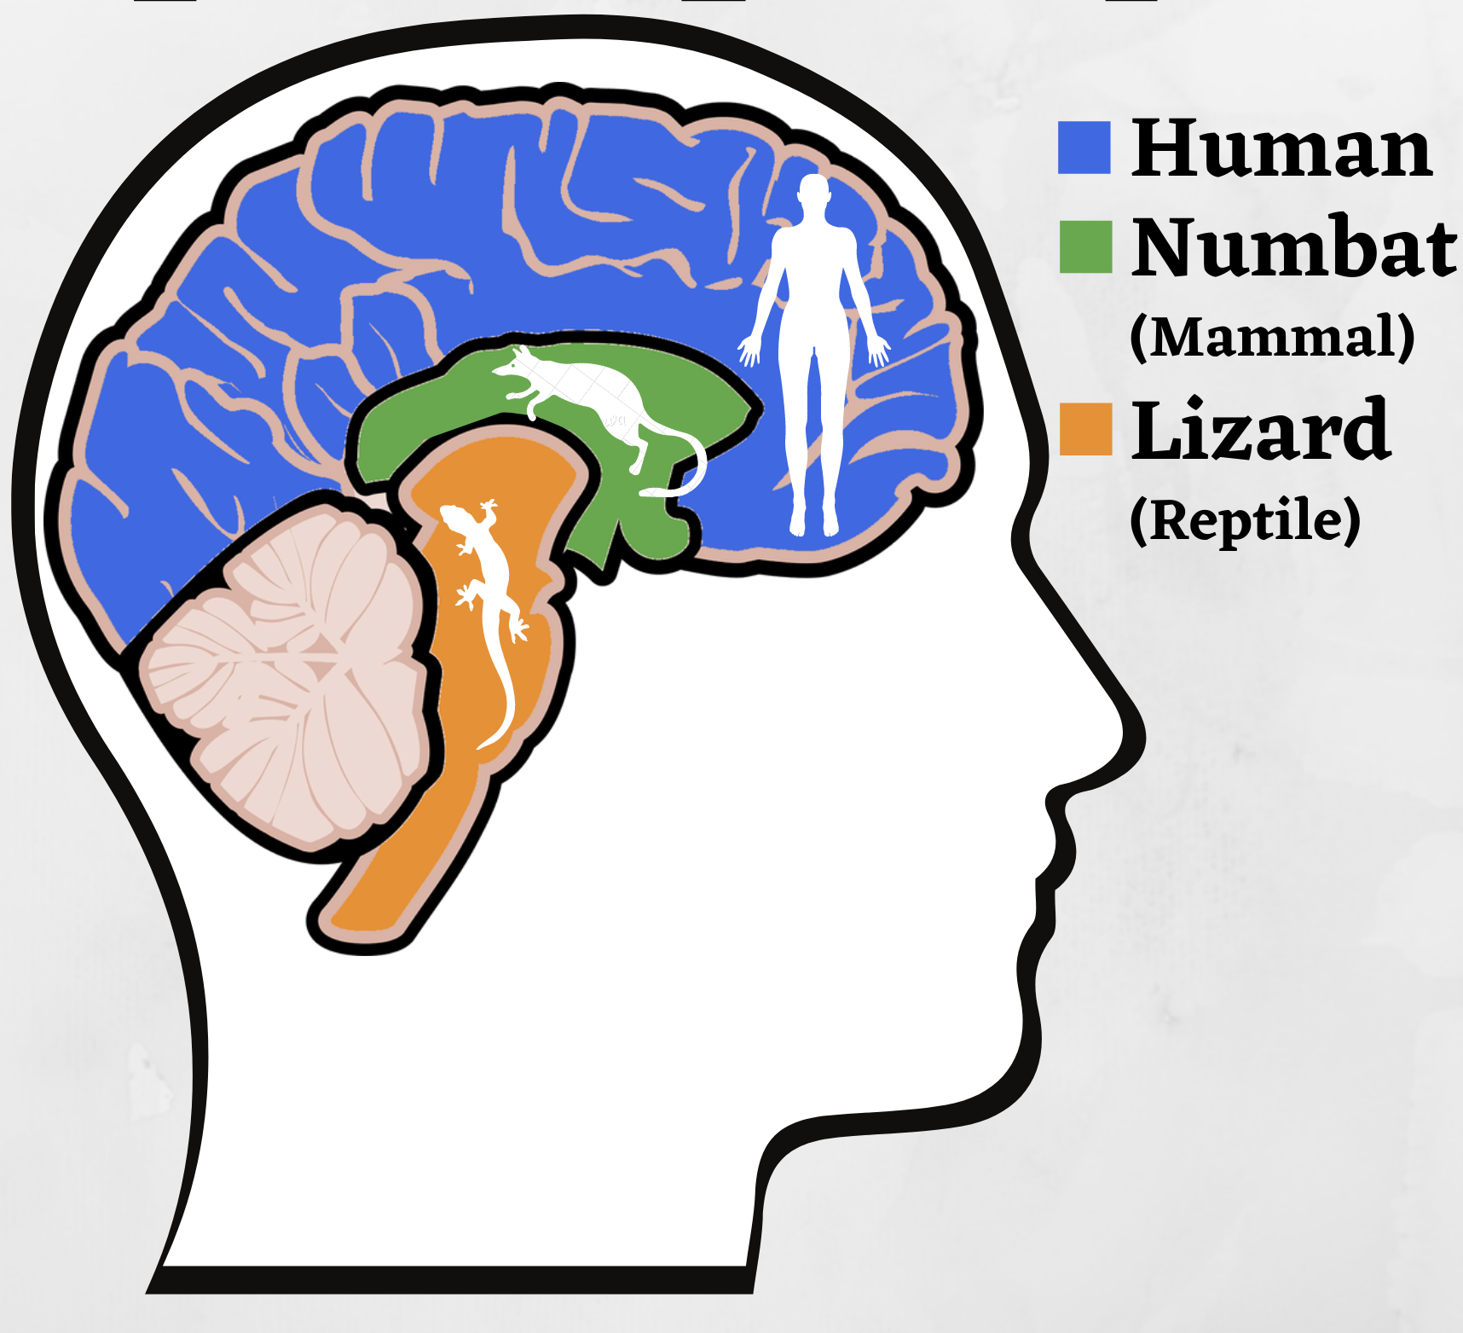
The Journey
Notes:
“The human brain is at the front of our head, right behind our forehead. The numbat brain brain is between the human brain and the lizard brain. The lizard brain is at the back of our head where our neck connects.”

