Slide 1

Grade 6
Lesson 3: Who’s the Boss?

Slide 2

Focused Awareness: Okinaga Breathing
Cue video: Okinaga breathing exercise.
Notes:
Teacher Script:
“Today we are going to learn about Okinaga: the breathing practice which involves deep, prolonged exhalations from the abdomen through the mouth, and controlled inhalations through the nose. This type of breathing comes from Japan and is meant to cultivate the psycho-physical attributes that are necessary for the capacity to experience life in the present or to live in the martial way. If you have ever done martial arts, you may have heard of this practice.”
“Let’s watch this video which explains how to do Okinaga.”
Cue video: Okinaga breathing exercise.
“Let’s try this practice together. FIrst get comfortable. Now breathe in for 15 seconds, then breathe out for 15 seconds. Make sure you are breathing in through your nose and out through your mouth. Try to open the back of your throat as you do this. Fill up your stomach and your diaphragm with air. Try not to gasp at the end of the exhale. Try to stay calm and relaxed.”
“Now we will do the same thing, but we will do 20 seconds in and 20 seconds out.”
“Now we will extend our breathing to 25 seconds in and 25 seconds out.”
“In martial arts, people work at breathing for up to 50 seconds in and 50 seconds out! This is something you can work up to.”
“Practicing Okinaga helps you to let go of the past and stay in the present moment. You can practice this type of breathing any time you are feeling overwhelmed.”

Slide 3
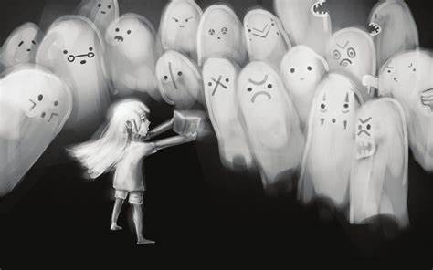
Quote to Consider
“Don’t be afraid of your fears. They’re not there to scare you. They’re there to let you know that something is worth it.” - C. Joy Bell

Slide 4

Talking About Fear…
Have you ever felt scared to do something?
How did your body let you know that you were feeling fear?
Notes:
Teacher Script:
“Today we’re going to talk more about how our brains, hearts, and bodies work together to help us to choose courage, do the right thing, and to make positive choices. We’ll get a better understanding of the parts of the brain and their functions. And we’ll also see what happens to our brains when we feel scared, anxious, or overwhelmed.”
“Has anyone ever been in a situation where they felt scared to do something?”
Share your own personal example, describing the situation including what you were doing, feeling, and thinking. Allow a few students to share their examples. Normalize fear as a natural response and thank them for showing courage by sharing.
“How did your body let you know that you were feeling fear?”
Examples include: heart racing, body tense, eyes wide, upset stomach, trouble breathing, sweating, feeling hot, jittery, trouble focusing, etc”
“Everybody has fear and that’s not a bad thing. In fact, fear is a really important feeling. It is how we respond to real or perceived physical or emotional danger, threat, pain, evil, harm, or unfavorable situations. Fear can be a distressing and powerful emotion. It is really vital because it’s like an alarm inside us that alerts us to potential danger. If we didn’t have or experience fear, we wouldn’t be able to protect ourselves from real threat or harm. But as I mentioned before, sometimes we are fearful of something that is perceived, something that isn’t real, something that is imagined or exaggerated, or something that is really not a true threat or harm to us. While fear can call and move us to action when it’s necessary, fear can also paralyze us and interfere with our ability to have a happy, healthy, productive life."

Slide 5
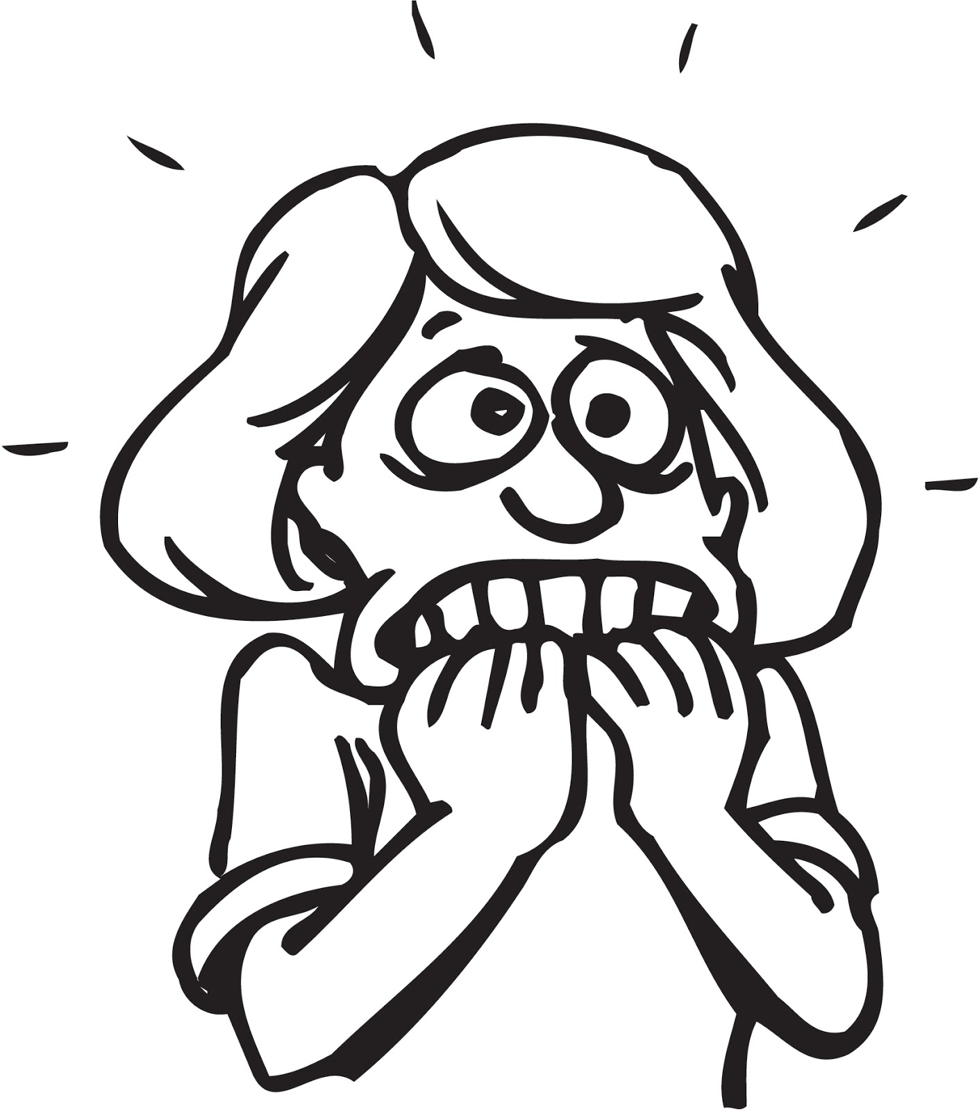
Fear is Necessary
In caveman times fear:
Helped us survive
Kept us aware of the dangers around us.
In today’s world:
We must make sure we are aware of our feelings of fear.
We must address our feelings of fear and evaluate where it is coming from.
Fear helps keep us safe.
Notes:
Teacher Script:
“Fear is necessary, but we need to have a healthy and realistic level of fear. In our caveman days we needed fear to survive. It kept us aware of all of the dangers around us. In today’s world we do not need this constant fear. We must make sure we are aware of our feelings of fear. We need to acknowledge our fear and figure out if it’s coming from something that is a real danger, or something we’ve created, imagined, or exaggerated. It’s important to have ways to address our fear so that it’s helpful and not harmful to us. We need to stop and think through our fear, evaluate where it’s coming from and if it’s a true call to action or perhaps an invitation to be courageous, a time to ask for help, or a time to let it go because it’s not serving us in any way.”
“In future lessons, we will talk about a few ways to calm down when we are anxious, nervous, afraid or uncertain.”

Slide 6
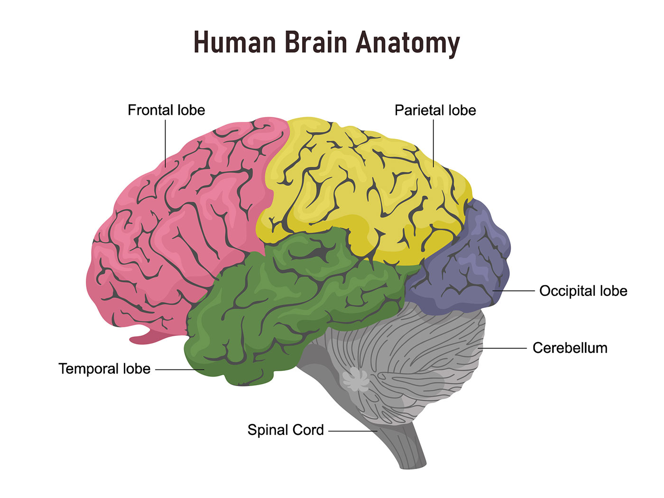
How the Brain Works
Cue Video: The Brain for Kids
Notes:
Teacher Script:
“It is important to understand how our brains work so that we can better understand why we react and think like we do. Let’s watch a video about the brain. We will discuss it afterwards.”
Cue Video: The Brain for Kids
“What do you think about this video? What did you learn about your brains?”

Slide 7
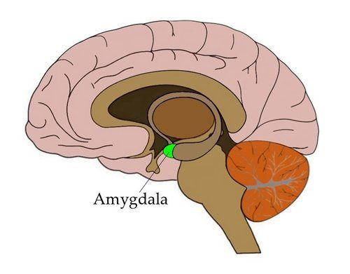
The Amygdala
Cue Video: Fight, Flight or Freeze Video
Notes:
Teacher Script:
“Now we are going to learn about a very important part of our brain…the Amygdala. Pay attention to the video. We will discuss the Amygdala afterwards.”
Cue Video: Fight, Flight or Freeze Video
“What did you learn about the Amygdala? Who can tell me why the amygdala is important?
Allow for discussion

Slide 8
Activity: Reptile, Numbat or Human Brain
You are home and see flames coming out of your building.
As usual, your sister is taking too long in the bathroom in the morning.
You loaned a friend your favorite book; now he can’t find it.
You grab the handle of a pan on the stove before you realize it’s very hot.
You are swimming and you see a shark swimming toward you.
You are trying out for a team or performance and you don’t get chosen.
Someone throws food at you in the cafeteria.
You are riding your bike down the street when you see a speeding car coming right at you.
Notes:
Teacher Notes:
“I'm going to break you into small groups and then give you different scenarios. You are going to decide whether we should use the Reptile (controls breathing, heart rate and temperature as well as helps us stay alert and reactive to our environments), Numbat (responsible for emotions and social behavior) or Human (helps to think clearly and problem solve) parts of our brain. You can take turns reading the scenarios. Decide as a group which brain you should use and why. Talk about what you would do in each situation.”
You are home and see flames coming out of your building.
As usual, your sister is taking too long in the bathroom in the morning.
You loaned a friend your favorite book; now he can’t find it.
You grab the handle of a pan on the stove before you realize it’s very hot.
You are swimming and you see a shark swimming toward you.
You are trying out for a team or performance and you don’t get chosen.
Someone throws food at you in the cafeteria.
You are riding your bike down the street when you see a speeding car coming right at you.
Give students time to discuss the scenarios.
“Okay. How did this activity go? Does anyone have anything they want to share? Let’s go through each one and figure out what brain you should use.”

Slide 9

Choose Love Journal: Parts of Our Brains
Today we are going to be writing about times we used different parts of our brains.
Take a few moments to think about times you may have immediately reacted instead of taking the time to pause and reflect on the situation and think through possible reactions.
Write about these moments and how you could have reacted in a more positive, productive way.
Notes:
Teacher Script:
“Take out your Choose Love Journals and open up to the next blank page. Today we are going to be writing about times we used different parts of our brains. Take a few moments to think about times you may have immediately reacted instead of taking the time to pause in the Choice Moment and reflect on the situation to think through possible responses. Write about these reactive times and how you could have used the Choice Moment to thoughtfully respond in a more positive, productive way.”
Give students 3 - 5 minutes to write.
“Would anyone like to share anything they wrote?”

Slide 10







Call to Action! (Lessons to Life)
Teach family members or friends about the lizard brain, the numbat brain and the human brain and what the functions of each part are.
Make a social media post about the different parts of the brain and act out how each part functions.
Keep a journal and write about various situations you have been in when you needed to stop and think rather than react. Write about the ways this helped you make better choices.
Be aware of the different parts of your brain throughout the day. Be mindful of when you need to react and when you should stop and think.
Do the “future me” activity with your friends. Share the advice your future self would give your current self.
Notes:
Teacher Script:
Here is today’s call to action items:
Teach family members or friends about the lizard brain, the numbat brain and the human brain and what the functions of each part are.
Make a social media post about the different parts of the brain and act out how each part functions.
Keep a journal and write about various situations you have been in when you needed to stop and think rather than react. Write about the ways this helped you make better choices.
Be aware of the different parts of your brain throughout the day. Be mindful of when you need to react and when you should stop and think.
Do the “future me” activity with your friends. Share the advice your future self would give your current self.

